Slide 1


SHOPPING BEHAVIOR ANALISYS
Convenience at Your Fingertips
Leveraging 3,900 transactions to decode purchasing patterns and optimize business strategies

Slide 2

INTRODUCTION
Understanding Consumer Behavior Through Data
In today's competitive retail landscape, understanding customer purchasing behavior is crucial for business success. However, many companies struggle to identify clear patterns in how different demographic segments make purchasing decisions.

Slide 3

METHODOLOGY
How we conducted the analysis
Dataset: 3,900 purchase transactions
Key variables: Age, Gender, Purchase Amount
Techniques: Statistical analysis and data visualization
Objective: Identify patterns for strategic segmentation

Slide 4

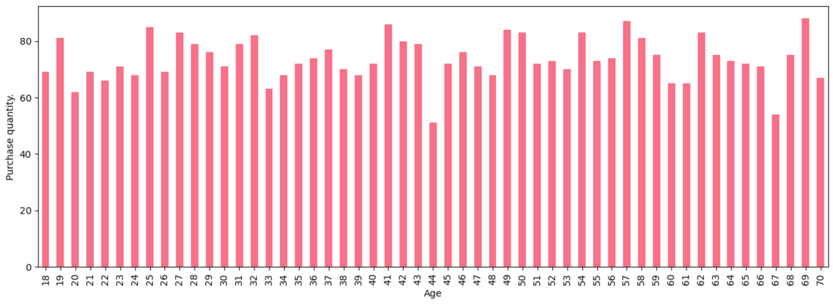
Analyzing Data
AGE
In this first analysis, I identified the number of items purchased by age.
As we can see, this type of visualization generates a very cluttered graph, and while easy to understand, it's not very pleasing to the eye.

Slide 5
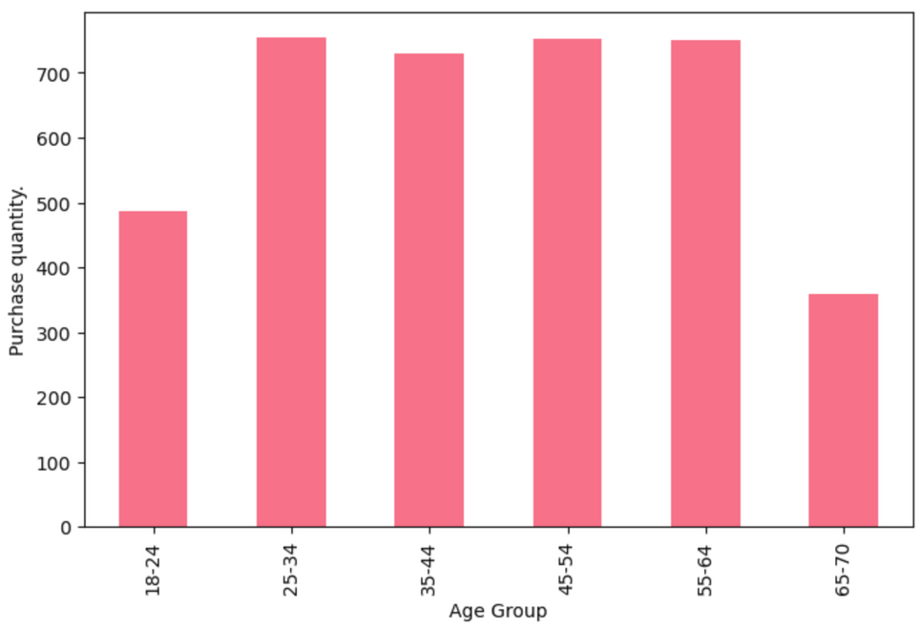
Analyzing Data
AGE
Therefore, I created an analysis based on age groups, which generates a more visual graph and will help with future analyses.
Here we can see that, in the early years of adulthood, the number of items purchased is lower compared to later years.
We can also see that in the 65-70 age group, the number of purchases also drops significantly.

Slide 6
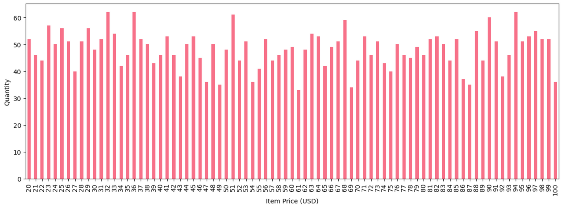

Analyzing Data
PURCHASE VALUE
The same happens when we analyze the value of each item purchased. A graph cluttered with too much information.
I created a graph that plots item prices by the number of times items with that value were purchased.

Slide 7
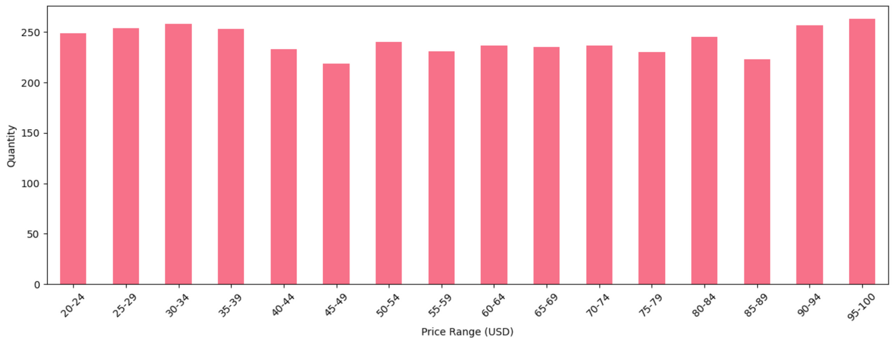
Analyzing Data
PURCHASE VALUE
By generating a graph with price ranges, we can better observe that even with some minimal variation, the quantity of items purchased does not seem to be affected by the sales price.

Slide 8
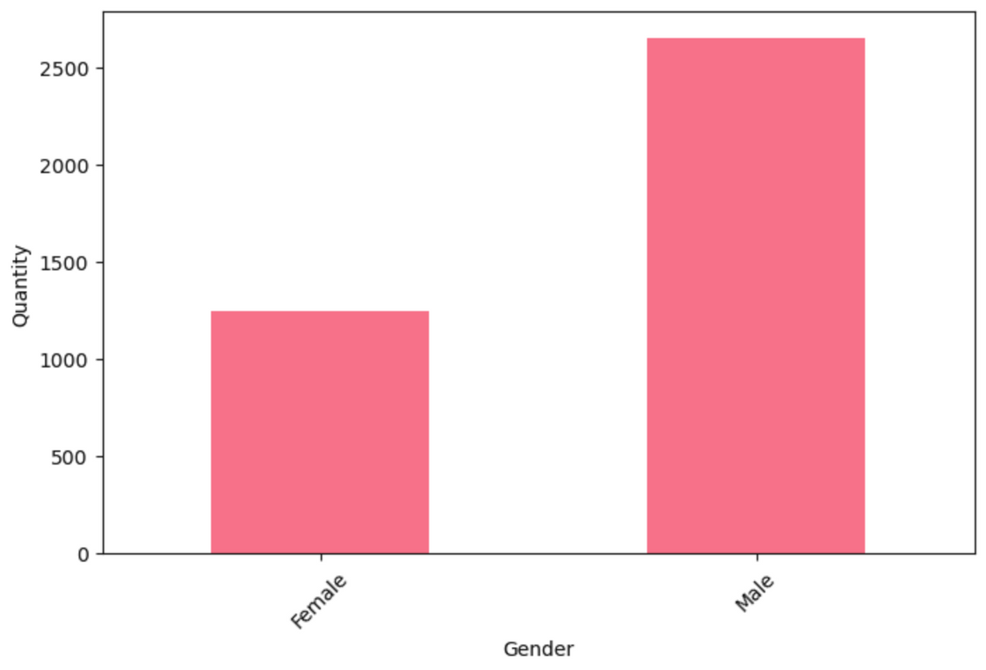

Analyzing Data
GENDER
We can see that, in this analyzed data, men are responsible for 68% of purchases, an total of 2,652 units.
Women are responsible for the remaining 22%, representing an total of 1,248.

Slide 9
BIVARIATE ANALYSIS
Comparing Categories
After analyzing the categories individually, we'll begin comparing them to see if there's any correlation between them.
These will be:
Age Impact on Spending (Age x Purchased Values)
Age and Gender Distribution (Age x Gender)
Gender-Based Behavior (Gender x Purchased Values)

Slide 10
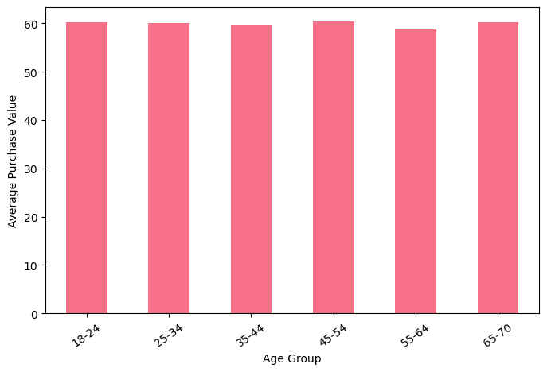
Analyzing Data
AGE IMPACT ON SPENDING
We can see that the average purchase value remains practically the same in all age groups

Slide 11
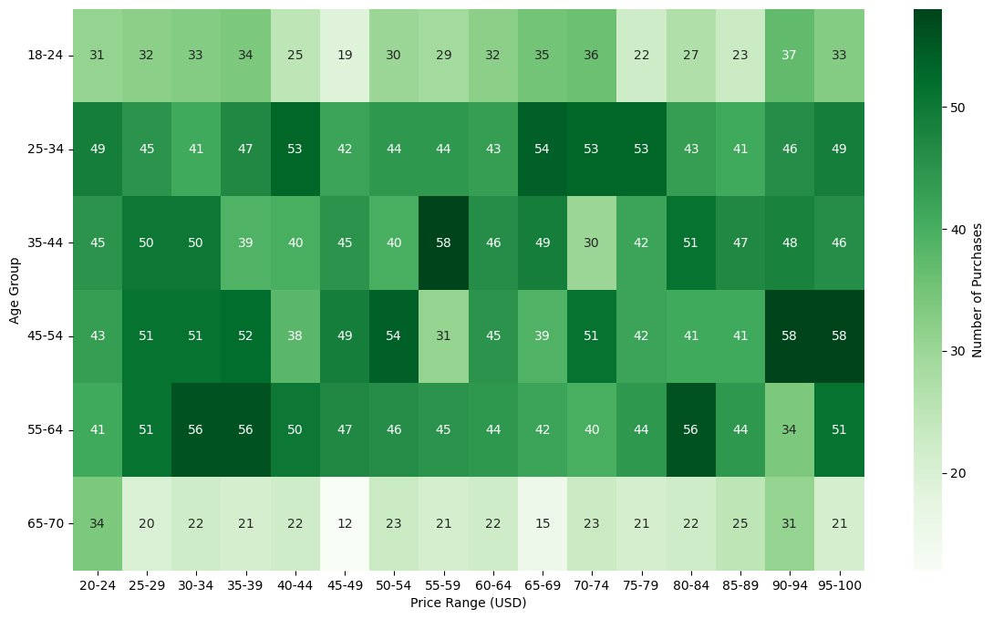
Analyzing Data
AGE IMPACT ON SPENDING
This heatmap shows a clear trend between age and spending. Younger and middle-aged groups (18-64) favor mid-range prices, while the oldest segment (65-70) consistently prefers the lowest prices.

Slide 12
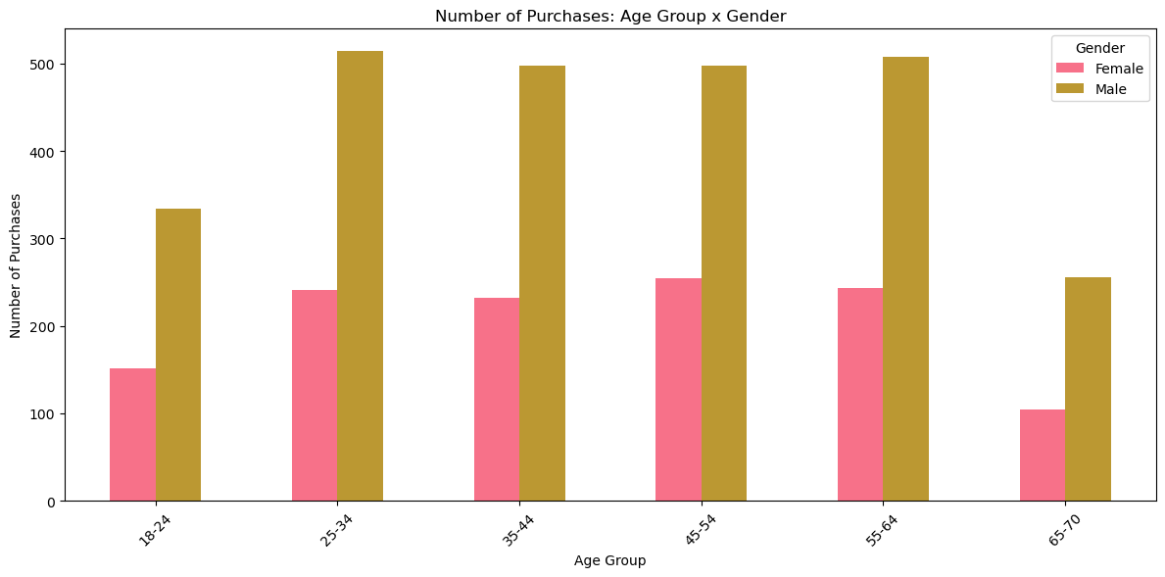
Analyzing Data
AGE AND GENDER DISTRIBUTION
Here we can see that even within age groups, men are responsible for the majority of purchases made in this store.

Slide 13
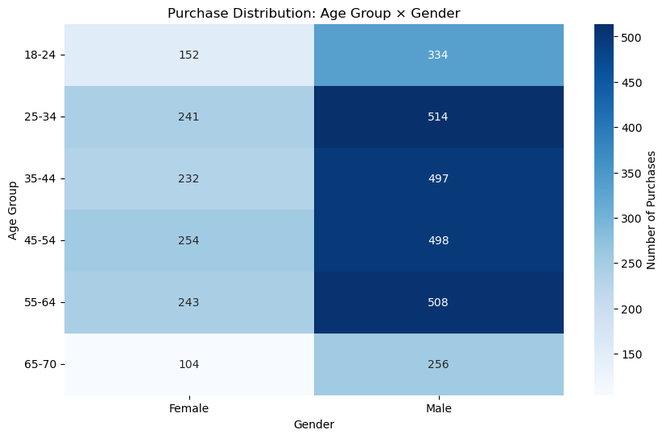
Analyzing Data
AGE AND GENDER DISTRIBUTION
And from this heatmap, we can see that most of this store's customers are men between the ages of 25 and 64.

Slide 14
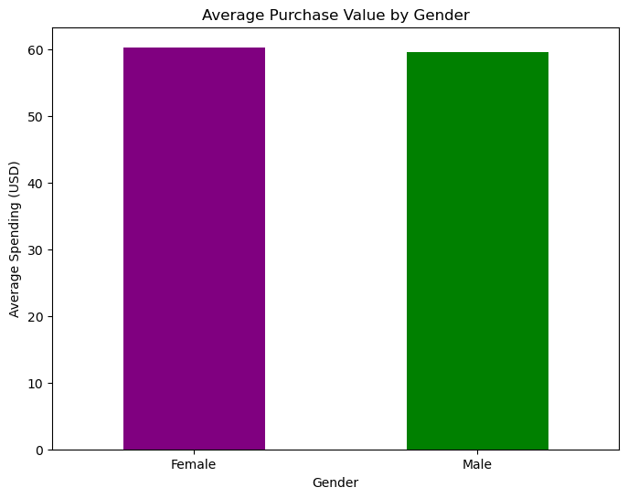
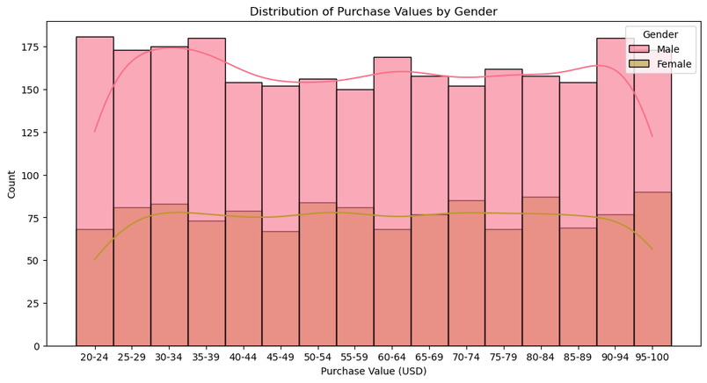
Analyzing Data
GENDER-BASED BEHAVIOR
Comparing these two graphs below we can see that, even though men are responsible for the majority of purchases, the value of the items purchased is practically the same for both genders analyzed.

Slide 15
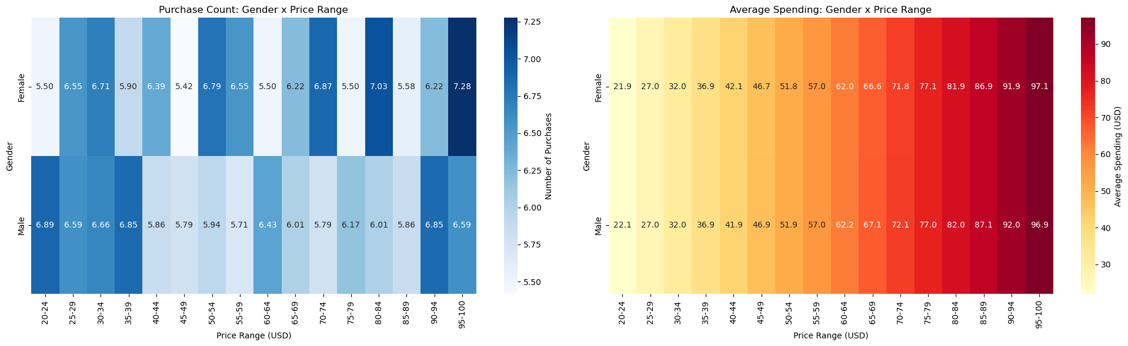
Analyzing Data
GENDER-BASED BEHAVIOR
In the heatmap on the left, we can see the comparison between price ranges and genders. Within each space, we see the percentage in which these price ranges appear for each gender.
In the heatmap on the right, we also see the comparison between price ranges and genders, but this time we observe the average value within each price range.

Slide 16

FINAL CONCLUSIONS

Slide 17
FINAL CONCLUSIONS
Age Impact on Purchasing Behavior
Optimal segment: Customers aged 45-64 show the highest average spending
Younger demographics: 18-24 age group has the lowest purchasing power
Senior decline: Spending decreases after 65, likely due to retirement and changing needs
2.Gender-Based Patterns
Remarkable similarity: Male and female customers show very comparable spending behaviors
Consistent distributions: Both genders follow similar patterns across price ranges
Minor variations: Small differences exist but no significant gender-based spending gaps

Slide 18
FINAL CONCLUSIONS
3. Combined Demographic Insights
Homogeneous behavior: Age and gender interactions show consistent patterns
Price sensitivity: All demographic segments respond well to mid-range products ($45-89 USD)
Lack of extreme segmentation: No radical differences in purchasing behavior across groups
4. High-Value Customer Identification
Primary target: 45-64 age range represents the most valuable customer segment
Stable base: 25-54 age groups provide consistent purchasing volume
Growth opportunity: Younger demographics (18-24) offer potential for loyalty development

Slide 19

THANK
YOU

